Slide 1
Rewards Marketing
Callum Herbert 17/04/18

Slide 2
About Amplify
We are a multi-national customer acquisition platform and ePerformance consultancy.
Set-up by the founder of The Specialist Works and other senior members of The Specialist Works
Our advertisers include e-commerce brands and agency partners empowered for growth.
We deliver digital customer acquisition that is measurable, workable and scalable through ePerformance channels.

Slide 3
AMP Rewards Marketing

Slide 4
Introducing Rewards Marketing
“Rewards Marketing” is the ultimate form of Performance Marketing.
Companies like UBER and Chase Bank want to reward their customers and promote loyalty – They do this through a range of exclusive "rewards/offers”
Amplify create profitable partnerships (and happy customers!) between Advertisers and Publishers through the provision of Rewards.
Rewards don’t feel like advertising!

Slide 5
The AMP Platform
Brand Partners are Advertisers that provide their strongest possible offers to our Reward Publisher Network: a selection of loyalty and membership platforms that display rewards and offers to their highly engaged user bases.

Slide 6
AMP Reward Publishers

Slide 7



Reward Publishers

Slide 8
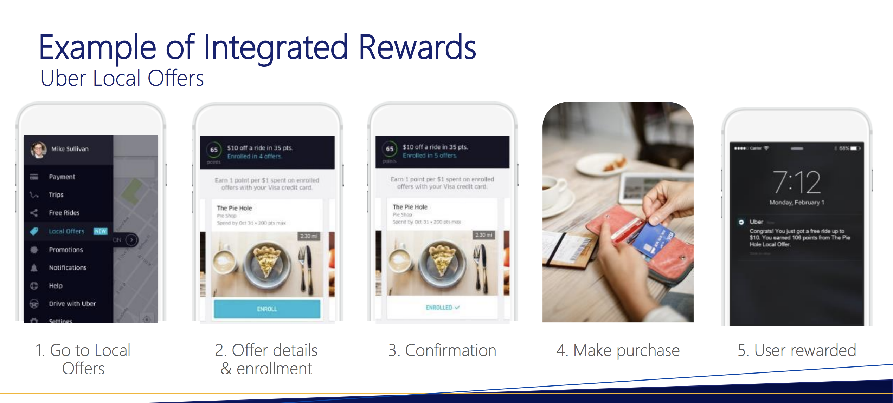
UBER

Slide 9
Meet Sweatcoin: an AMP Reward Publisher

Slide 10
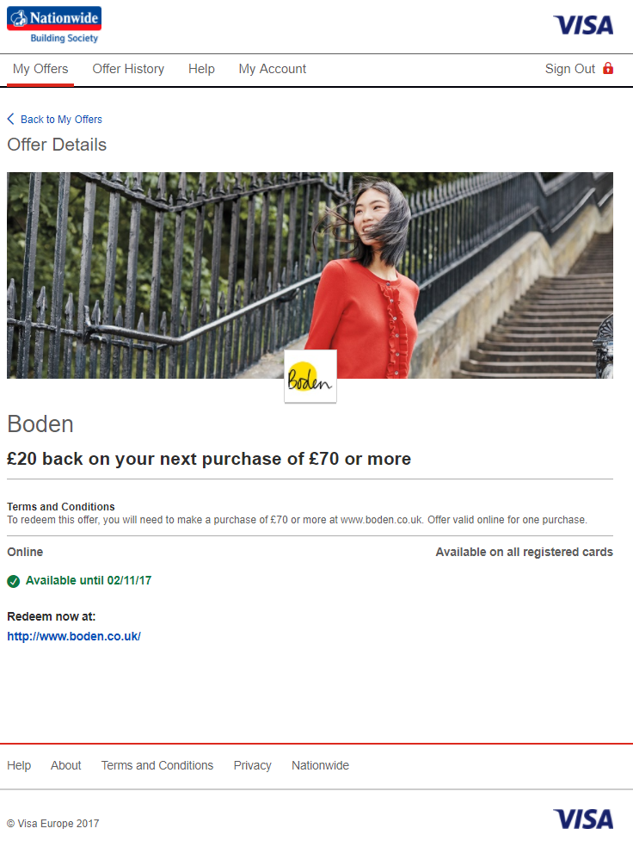
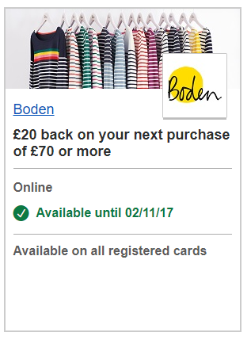
Boden

Slide 11
The Rewards Marketing Difference!
Unique Proposition
Walled Garden; not publicly accessible offers
End-user is ACTIVELY browsing reward offers
CPA only!
Reach highest quality customers

Slide 12
Our 3-step Onboarding Process
Agree offer and creative
Get Reward Publisher approval
LAUNCH!

Slide 13
AMP Brand Partners

Slide 14
Example Brand Partners

Slide 15
Who we accept and why
Almost all digital advertisers can become a Brand Partner, provided they have a strong offer!
Amplify currently work with a range of Brand Partners, from fast-growth eCommerce subscription brands to established global blue-chips.
The only exclusion is gambling.

Slide 16
Performance & Scale

Slide 17
Graze – Micro Case Study
~1,600 new customers acquired at a fixed £7.50 CPA – beating other digital acquisition channels.
Customer quality far in excess of the affiliate channel.

Slide 18
Moving Forwards

Slide 19
Working with TSW…
White Label We manage campaigns on your behalf, but do not deal with the client directly. Amplify become simply another supplier/platform.
Client Contact We deal with the client directly and pass an agreed commission/fee back to you for all activities.

Slide 20
Next Steps
Amplify would look for a Brand Champion within TSW US.
A dedicated Account Manager would be provided by Amplify for all queries, from pitch to billing.

