Slide 1
Holidays and Consumers 2018

Slide 2
Executive Summary
Gift giving holidays are a great time for most businesses to reach out to consumers, as they spend substantially more during these periods. These are the best times to maximize your advertising dollars
  Mother’s Day – Consumers spent $23.6 billion
  Halloween – Consumers spent $9.1billion
  Valentine’s Day – Consumers spent $18.2 billion
The Money Mailer select affluent audience is an ideal target for gift giving holidays. Our consumers compare favorably to the U.S. average.
  74% higher income
  50% more on gift giving
  27% more likely to purchase online
  46% more likely to purchase gifts online or over the phone
Money Mailer distributes 12 months of the year covering all gift giving holidays. This has been an optimal time for many of our clients like Teleflora, Popcorn Factory, Harry & David, and other national brands to acquire new customers during these special gift giving periods.

Slide 3




Money Mailer’s National Consumer Profile
Affluent Engaged Consumer
  74% higher household income
  21% more likely to be married
  11% more likely to have children
  49% more likely to give gifts of clothing
  49% more likely to give gifts of flowers
  46% more likely to order gifts online or over the phone
Sources: Census Data, Bureau of Labor Statistics Consumer Expenditure Survey, MRI Consumer Behavior Survey
MMR Coupon Usage and Attitude Research January 2018
Notes:
Our readers are affluent women, a little older than the US average, married & with children, homeowners with 2+ cars
Our open rate is 96% One out of five readers passes MM inserts on to others

Slide 4










Our Advertising Environment – Local!
We are the local gift giving neighborhood shopping experience. This hyper local environment is an ideal vehicle for national advertisers to reach out to consumers around gift giving holidays.
Chicago, IL
Charlotte, NC
Houston, TX

Slide 5
Gift Giving Holiday Case Study
Situation:
A online men’s clothing retailer was interested in testing shared mail for the first time. The company utilized television, radio, catalogs, and email to acquire new customers.
The company tested Money Mailer for a 4 week period leading into a major holiday.
Analysis:
A match-back analysis compared the mailed versus non-mailed households for change in customer acquisition after the completion of the campaign.
RESULTS:
The Money Mailer campaign customer acquisition cost was 20% lower with a 25% higher average ticket size!
New client acquisition cost through Money Mailer was 20% lower and the average ticket size was 25% higher!
Follow on Activity:
Client immediately added an additional campaign with Money Mailer in a normally dormant advertising period. Client is adding Money Mailer as a key strategy into its marketing calendar.
Date Range: May 2017
# of Households Mailed: 3 million
# of Markets Mailed: 13

Slide 6
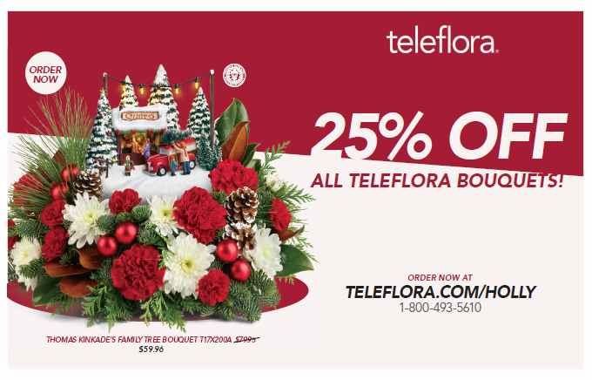
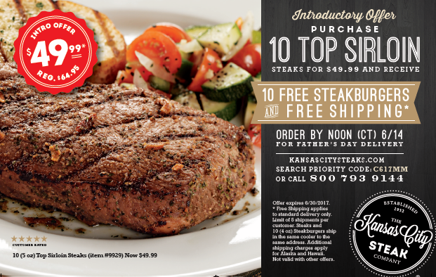

Current Seasonal Holiday Advertisers
Teleflora
Kansas City Steaks
Wine Country Gift Baskets
Fragrancenet.com
Popcorn Factory
Macy’s Wine Cellar
Cushman’s Fruit
Yankee Candle
Omaha Steaks

Slide 7

Valentine’s Day
In home date window of 1/5/18 – 2/9/18
12,490,000 available
Consumer spend of 18.2 billion in 2017
Customized email campaign

Slide 8

Easter
In home date window of 2/16/18- 3/23/18
17,130,000 available
Consumer spend of 18.4 billion in 2017
Customized email campaign

Slide 9

Mother’s Day
In home date window of 3/31/18 – 5/4/18
18,620,000 available
Consumer spend of 23.6 billion in 2017
Customized email campaign
500,000 free back of envelopes
  8 week lead time to secure back of envelope
  3 million insert minimum

Slide 10

Graduation
In home date window of 4/16/18 – 5/21/18
18,700,000 available
Consumer spend of 5.6 billion in 2017
Customized email campaign
500,000 free back of envelopes
  8 week lead time to secure back of envelope
  3 million insert minimum

Slide 11

Father’s Day
In home date window of 5/4/18 – 6/8/18
18,550,000 available
Consumer spend of 15.5 billion in 2017
Customized email campaign
500,000 free back of envelopes
  8 week lead time to secure back of envelope
  3 million insert minimum

Slide 12
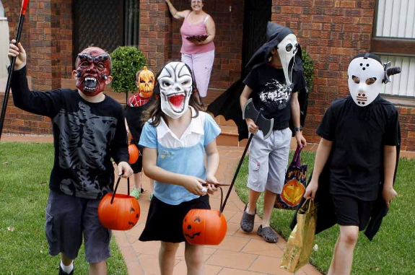
Halloween
In home date window of 9/12/18 – 10/17/18
20,890,000 available
Consumer spend of 9.1 billion in 2017
Customized email campaign
500,000 free back of envelopes
  8 week lead time to secure back of envelope
  3 million insert minimum

Slide 13

Thanksgiving and Christmas
In home date window of 10/26/18 – 12/14/18
28,960,000 available
Consumer spend of 465 billion in 2017
Customized email campaign
500,000 free back of envelopes
  8 week lead time to secure back of envelope
  3 million insert minimum

Slide 14
Summary
Gift giving holidays are a great time to reach out to consumers, as they spend billions of dollars in the weeks leading up to each of them.
Money Mailer offers an ideal target audience for these holidays. They have a median household income 74% above the national average, and spend 50% more on gift giving.
Our packages offer a great way to reach America’s best consumers leading up to every gift giving holiday.

