Slide 1

The Brampton Guardian is an award-winning newspaper serving the City of Brampton and a large ex-urban area, northwest of Toronto. The Guardian serves the centre of Peel Region, a large market with above-average household income, and is one of Metroland's best-read newspapers.
In-paper display advertising
Booking Deadlines – 4 business days prior to insertion date
Mmaterial Deadlines – 3 Business days prior to the insertion date
Free Standing Inserts
Product must be in the warehouse 5 business days prior to the distribution date.

Slide 2
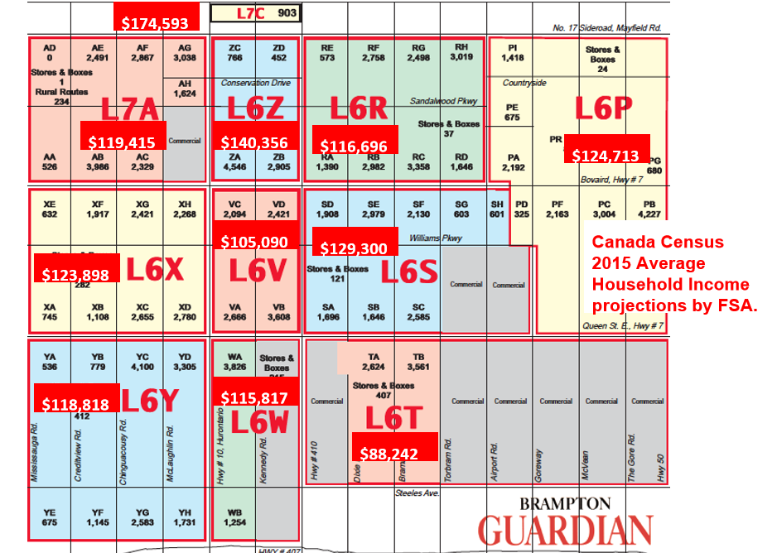
FSA by Household income

